Slide 1
Predictive Modeling—Dimensionality Reduction
DSBA/MBAD 6211: Advanced Business Analytics
Spring 2024

Slide 2
High Dimensionality
Real data usually have hundreds, thousands, or even millions of dimensions
Examples:
Health status of patients: 100+ measured/recorded parameters from blood analysis, immune system status, genetic background, nutrition, alcohol- tobacco- drug-consumption, operations, treatments, diagnosed diseases, ...
Seller reputation: Seller rate, Percentage of seller good rate, Description score, Description votes, Service score, Service votes, Delivery score, Delivery votes, Placement on search results, Violation, Return conflict, Complaint
Web documents, where the dimensionality is the vocabulary of words
Facebook graph, where the dimensionality is the number of users
Notes:
Definition of dimensionality: The dimensionality of a model is the number of predictors or input variables used by the model
Examples

Slide 3
The Curse of Dimensionality
Problems with high-dimensional data
Number of samples required
Running time
Multicollinearity
Data becomes very sparse, some algorithms become meaningless (e.g., density-based clustering)
The complexity of some algorithms depends on the dimensionality, and they become infeasible
Notes:
The proliferation of variables means that nothing is close to anything else anymore—too much noise has been added and patterns and structure are no longer discernible.
Sparse: variations reduce → 1) statistical significance and 2) clustering analysis--> every observation appear equidistant from all the others; the distance are all approximately equal, then all the observations appear equally alike
Number of samples required: In machine learning problems that involve learning a "state-of-nature" from a finite number of data samples in a high-dimensional feature space with each feature having a range of possible values, typically an enormous amount of training data is required to ensure that there are several samples with each combination of values. In an abstract sense, as the number of features or dimensions grows, the amount of data we need to generalize accurately grows exponentially.^{[4]}
Complexity: Nearest neighbor search? As dimensions increases, all the points are further away. You need to look further to away to get the same amount of point.
The dimensionality curse phenomenon states that in high dimensional spaces distances between nearest and farthest points from query points become almost equal. Therefore, nearest neighbor calculations cannot discriminate candidate points.
Examples about other algorithms: https://stats.stackexchange.com/questions/186184/does-dimensionality-curse-effect-some-models-more-than-others

Slide 4
Dimensionality Reduction
Usually, the data can be described with fewer dimensions, without losing much of the meaning of the data.
The data reside in a space of lower dimensionality
Essentially, we assume that some of the data is noise, and we can approximate the useful part with a lower dimensionality space.
Dimensionality reduction does not just reduce the amount of data, it often brings out the useful part of the data

Slide 5
Why Reduce Dimensions
Discover hidden patterns
Remove redundant and noisy features
Interpretation and visualization
Easier storage and processing of the data

Slide 6
Approaches
Incorporating domain knowledge to remove or combine categories
Using data summaries to detect information overlap between variables
Using data conversion techniques such as converting categorical variables into fewer categories
Employing automated reduction techniques (e.g., PCA).

Slide 7
The Role of the Target Variable
Supervised method
Use the target variable in the reduction method
Unsupervised method
Ignore the target variable in the reduction method

Slide 8
Outcome
Variable selection
Use one or a subset of the original variables as inputs into subsequent models
Dimension reduction
Use combinations of the original variables as inputs into subsequent models

Slide 9
Comparison of Methods
Method | Target | Outputs
PCA | Not used | Constructed
Variable Clustering | Not used | Original or Constructed
LAR/LASSO | Used | Original
Linear discriminant analysis (LDA) | Used | Constructed
Notes:
Go back to this slide later:
LASSO: is a regression analysis method that performs both variable selection and regularization in order to enhance the prediction accuracy and interpretability of the resulting statistical model.
LDA:

Slide 10
Dimensionality Reduction
Purposes:
Avoid curse of dimensionality
Reduce amount of time and memory required by data mining algorithms
Allow data to be more easily visualized
May help to eliminate irrelevant features or reduce noise
Techniques
Principal Component Analysis (PCA)
Singular Value Decomposition (SVD)
Others: supervised and non-linear techniques

Slide 11
Principal Component Analysis (PCA)
The idea:
Find linear combinations of variables that contains most, even if not all, of the information, so that these new variables can replace the original variables.
PCA is one of the oldest and most popular dimensionality reduction procedure.
Notes:
1. Each pair of new attributes has 0 covariance (for distinct attributes).
2. The attributes are ordered with respect to how much of the variance of the data each attribute captures.
3. The first attribute captures as much of the variance of the data as possible.
4. Subject to the orthogonality requirement, each successive attribute captures as much of the remaining variance as possible.

Slide 12
The First Principal Component
Scaling the data
Notes:
Rescale the data does not change the how the data is positioned relative to each other.
Make the 0,0 as the center of the data
Goal:
Is to find a projection that captures the
Largest amount of variation in data

Slide 13
The First Principal Component
Projection
1st principal vector
B
2nd principal vector
A
Notes:
Fit a line to fit the data; start from random lines
Linear combination that cross the center of the data
• Principal vectors are orthogonal
• Gives best axis to project to

Slide 14
The First Principal Component
Projection
A
Notes:
We want to find the projections that maximum the variances
To quantify how good the line fit the data, we project the data onto the line and then try to find the line that minimize the distance
The line spread out
• Find the eigenvectors of the covariance matrix
• The eigenvectors define the new space

Slide 15

The First Principal Component
Linear combination
$$pc1=w_{1}∗Fiber+w_{2}∗Potassium$$
First principal component is the direction of greatest variability (covariance) in the data
Notes:
Automatically, one line fit best.
The purpose of PCA is to find the best low-dimensional representation of the variation in a multivariate data set. We can capture most of the variation between samples using a smaller number of new variables , where each of these new variables is a linear combination of all or some of the variables.
Find the straight line where the data is most spread out when projected onto it. A vertical straight line with the points projected on to it will look like this:
Show the visualization
Pythagorean theorem: a^2 = b^2 + c^2

Slide 16


PCA approximating a high dimensional data set with a lower dimensional linear subspace
The second principal component
$$pc1=w_{1}∗Fiber+w_{2}∗Potassium$$
$$pc2$$
Notes:
The second PCA is calculated the same way, with the condition that it is uncorrelated with (i.e., perpendicular to) the first principal component and that it account for the next highest variance.
This process continues until a total of p pc have been calculated, equal to the original number of variables.
• Gives best axis to project
• Minimum RMS error
• Principal vectors are orthogonal!

Slide 17
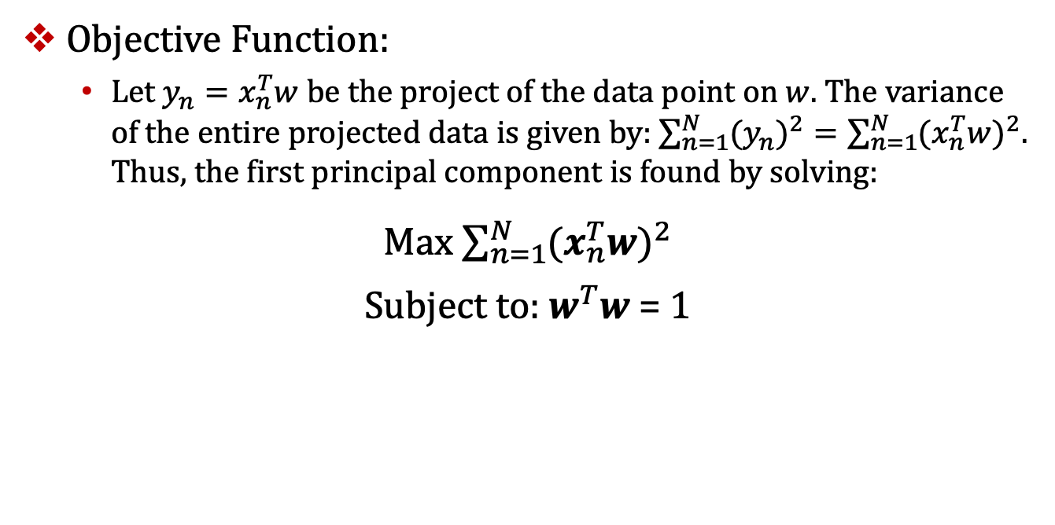
PCA Learning Rule
Objective Function:
Let $y_{n}=x_{n}^{T}w$ be the project of the data point on $w$. The variance of the entire projected data is given by: $\sum_{n=1}^{N}{{{(y}_{n})}^{2}=\sum_{n=1}^{N}{{{(x}_{n}^{T}w)}^{2}}}$. Thus, the first principal component is found by solving:
Max $\sum_{n=1}^{N}{{{(x}_{n}^{T}w)}^{2}}$
Subject to: $w^{T}w$ = 1

Slide 18
PCA
From N original variables: x₁,x₂,...,x_{N}:
Produce k new variables: y₁,y₂,...,y_{N}:
y₁ = w₁₁x₁ + w₁₂x₂ + ... + w_{1N}x_{N}
y₂ = w₂₁x₁ + w₂₂x₂ + ... + w_{2N}x_{N}
...
y_{N} = w_{N1}x₁ + w_{N2}x₂ + ... + w_{NN}x_{N}
y_{N}'s are
Principal Components
such that:
y_{N}'s are uncorrelated (orthogonal)
y₁ explains as much as possible of original variance in data set
y₂ explains as much as possible of remaining variance etc.
Notes:
Linear combination of variables

Slide 19
Eigenvector
{w₁₁,w₁₂,...,w_{1N}} is 1st Eigenvector of correlation/covariance matrix, and coefficients of first principal component
{w₂₁,w₂₂,...,w_{2N}} is 2nd Eigenvector of correlation/covariance matrix, and coefficients of 2nd principal component
……
{w_{N1},w_{N2},...,w_{NN}} is kth Eigenvector of correlation/covariance matrix, and coefficients of kth principal component
Notes:
Eigenvectors:
Eigenvalues: maximum of the squared distance of each PC

Slide 20
PCA for Dimension Reduction
With N input variables, you can compute N principal components
Can ignore the components of lesser significance
You do lose some information, but if the eigenvalues are small, you don’t lose much
n dimensions in original data
calculate n eigenvectors and eigenvalues
choose only the first p eigenvectors, based on their eigenvalues
final data set has only p dimensions

Slide 21
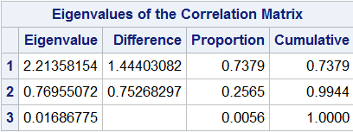
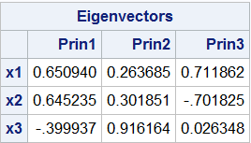
PCA Results

Slide 22
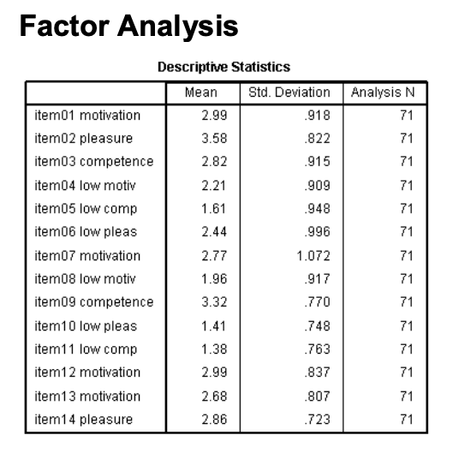
PCA example
https://tandfbis.s3.amazonaws.com/rt-media/pdf/9781848729995/IBM_SPSS_5e_Chapter_4.pdf

Slide 23
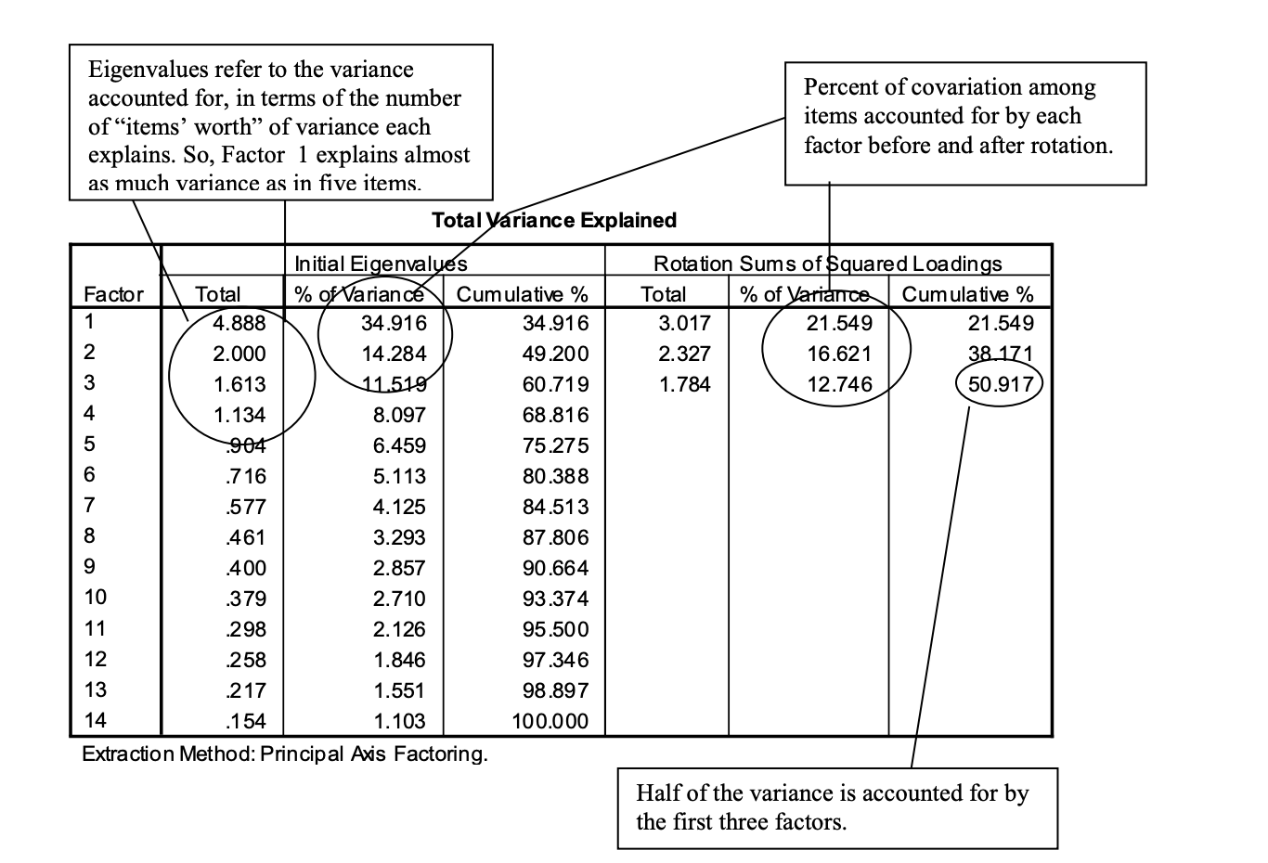
PCA example
https://tandfbis.s3.amazonaws.com/rt-media/pdf/9781848729995/IBM_SPSS_5e_Chapter_4.pdf
Notes:
% of variance = percentage of variance captured by the principal component
The total column gives the eigenvalue, or amount of variance in the original variables accounted for by each component, A rule of thumb, pick Eigenvalue > 1
Each eigenvalue has a variance of 1, after you do pca you need amount of variance that is grater than 1, that means it captures more info, the amount if of information is grater than in the original variable, all the ones with <1 should be dropped

Slide 24
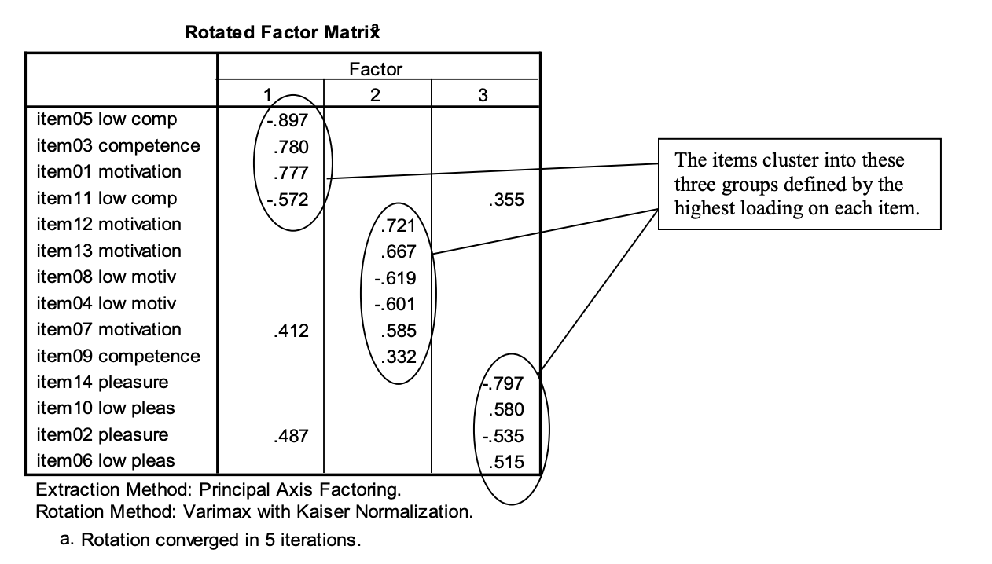
What are principal components
https://tandfbis.s3.amazonaws.com/rt-media/pdf/9781848729995/IBM_SPSS_5e_Chapter_4.pdf

Slide 25
PCA: Pros
Constructed output variables are definitely uncorrelated.
The selection order of the principal components is automatically determined.
Often, a very small number of principal components must be kept in order to explain a lot of the variations in the data cloud.

Slide 26
PCA: Cons
Difficult or impossible to interpret the constructed principal components.
All original input variables still used, since they build the principal components.
Misinterpretation of the coefficients of the linear combinations is common.

